Slide 1
time spent with TV remarkably stable
AVERAGE HOURS / WEEK
time spent with TV has been remarkably stable throughout the broadcast year so far, in fact TV viewing was up slightly while YouTube has seen some declines
ADULTS 18+ | Ontario
BROADCAST
YTD
Source: Numeris VAM, 09/2024 to 05/2025, Ontario
Total TV defined as linear TV and broadcaster streaming services | Streaming Services are ad-free and ad-supported services (in-home viewing only)

Slide 2
time spent with TV stable with young adults
AVERAGE HOURS / WEEK
YouTube doesn’t beat Total TV in time spent, even among young adults
ADULTS 18-34 | Ontario
BROADCAST
YTD
Source: Numeris VAM, 09/2024 to 05/2025, Ontario
Total TV defined as linear TV and broadcaster streaming services | Streaming Services are ad-free and ad-supported services (in-home viewing only)

Slide 3
US data is not a proxy for Canadian media
here’s the lay of the land: streaming in the US is much higher than in Canada, where our media habits more closely mirror those in the UK
SHARE OF VIEWING ON A TV SET
USA
CANADA
UK
US source: Nielsen Gauge, May 2025, P2+, viewing on a TV set (ex “other” viewing; proportionally adjusted)
Canada source: Numeris VAM, Ontario, May 2025, P2+, viewing on a TV set
UK source: BARB, May 2025, P4+, viewing on a TV set | “Streaming” = “Total SVOD/ AVOD” | “Video-sharing” is largely YouTube, but also includes TikTok, Twitch etc. (on a TV set)

Slide 4
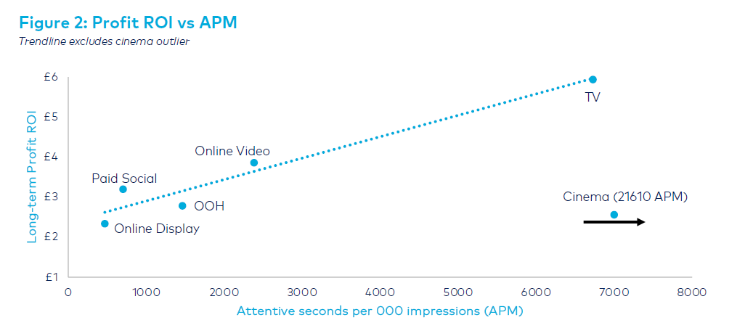
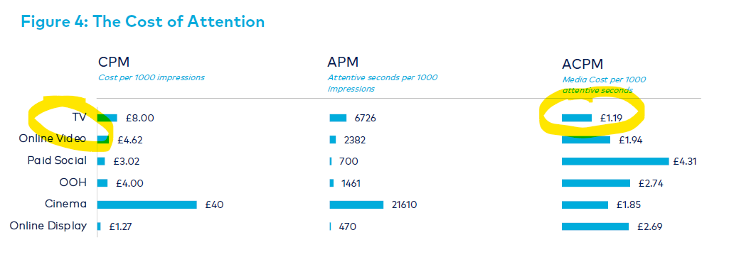
Source: Lumen, ebiquity
“Maximising Profit through Attention”
October 2024

Slide 5
linear TV’s reach exceeds all streaming services
AVERAGE WEEKLY REACH %
ADULTS 18+ | ONTARIO
LATEST VAM DATA
Full TV & Streaming Report Available
HERE
Source: Numeris VAM 09/16/24 to 5/25/2025, Ontario
Total TV defined as linear TV and broadcaster streaming services | Streaming Services are ad-free and ad-supported services (in-home viewing only)

Slide 6
Total TV = greatest share
of time spent with video
SHARE OF VIDEO
ADULTS 18+ | ONTARIO
Total
TV
Total
TV
LATEST VAM DATA
Full TV & Streaming Report Available
HERE
Source: Numeris VAM 09/16/24 to 5/25/2025, Ontario, all time spent per capita
Total TV defined as linear TV and broadcaster streaming services | Streaming Services are ad-free and ad-supported services (in-home viewing only)
Other Streaming Services: AppleTV+, CBS News, Club Illico, Crave (OTT Only), Crunchyroll, Daily Motion, DAZN, Discovery Plus, ET Online US, FuboTV, Paramount+, Pluto TV, Roku Channel, Samsung TV Plus, TED, TubiTV

Slide 7
…across key demos
SHARE OF VIDEO
ADULTS 25-54
ADULTS 18-34
ONTARIO
Total
TV
Total
TV
Total
TV
Total
TV
Total
TV
Source: Numeris VAM 09/16/24 to 5/25/2025, Ontario, all time spent per capita
Total TV defined as linear TV and broadcaster streaming services | Streaming Services are ad-free and ad-supported services (in-home viewing only)
Other Streaming Services: AppleTV+, CBS News, Club Illico, Crave (OTT Only), Crunchyroll, Daily Motion, DAZN, Discovery Plus, ET Online US, FuboTV, Paramount+, Pluto TV, Roku Channel, Samsung TV Plus, TED, TubiTV

Slide 8
viewers spend more time with Total TV
LATEST VAM DATA
Full TV & Streaming Report Available
HERE
Source: Numeris VAM, 09/16/24 to 5/25/2025 | Ontario | all time spent per capita
Total TV defined as linear TV and broadcaster streaming services | Streaming Services are ad-free and ad-supported services (in-home viewing only)

Slide 9
linear TV’s reach exceeds all streaming services for A18-43
AVERAGE WEEKLY REACH %
ADULTS 18-34 | Ontario
Source: Numeris VAM, 2/24/2025 to 5/25/2025, Ontario
Streaming Services include ad-free and ad-supported services (in-home viewing only)

Slide 10
most Canadians are
watching both Total TV
and streaming services
% OF VIEWERS
Source: Numeris VAM 09/16/24 to 5/25/2025, Ontario, % of composition of average weekly reach | Total TV = Linear and broadcaster streaming services
Streaming Services include: Prime Video, Netflix, Disney+, Apple TV+, Crave (OTT only), CBS News, Twitch TV, ET Online US, TubiTV DAZN, Paramount+, PlutoTV, FuboTV, Daily Motion, Roku Channel, Crunchyroll, Discovery+, TED, SamsungTV, YouTube
Notes:
The advantage premium content has – both TV & streaming platforms – is that the bulk of the viewing is on a big screen. This is much less true for YouTube.
This is important because we know that the biggest screen in the house delivers the highest attention. Innovid found that the interactive CTV campaigns on a television set delivery 4.6x higher engagement than on mobile, and 10.3 x higher than desktop. The big screen delivers big impact.

Slide 11
big screen,
big attention
linear TV makes up the majority of what we’re watching on a TV screen
Note: Streaming Services include ad-free and ad-supported services
Source: Numeris VAM, 09/16/24 to 5/25/2025, Ontario | Total Time (hours) on a TV / Smart TV device. Excludes Facebook Video, Instagram Reels, TikTok; Streaming Services include broadcaster streaming services

Slide 12

Linear TV reaches
90% of Quebec Franco
A18+ every week
90% 83% 81%
A18+
A25-54
A18-34
Source: Numeris PPM, 09/16/24 to 05/25/25, Quebec Franco

Slide 13
viewers spend more time with Total TV in Quebec
ADULTS 18+ | QUEBEC FRANCO
LATEST VAM DATA
Full TV & Streaming Report Available
HERE
Source: Numeris VAM, 09/16/24 to 5/25/25, Quebec Franco, all time spent per capita
Total TV defined as linear TV and broadcaster streaming services | Streaming Services are ad-free and ad-supported services (in-home viewing only)

Slide 14

Total TV = greatest share
of time spent with video
SHARE OF VIDEO
ADULTS 18+ | QUEBEC FRANCO
Total
TV
LATEST VAM DATA
Full TV & Streaming Report Available
HERE
Source: Numeris VAM, 09/16/24 to 5/25/25, Quebec Franco, all time spent per capita
Total TV defined as linear TV and broadcaster streaming services | Streaming Services are ad-free and ad-supported services (in-home viewing only)
Other Streaming Services: AppleTV+, CBS News, Club Illico, Crave (OTT Only), Crunchyroll, Daily Motion, DAZN, Discovery Plus, ET Online US, FuboTV, Paramount+, Pluto TV, Roku Channel, Samsung TV Plus, TED, TubiTV

Slide 15





the power of TV
in an attention
economy
we hope you found this report useful.
there’s much more we’d love to share.
click the links below and let’s connect.
subscribe
follow
reach out

